Slide 1


WebDriver Advanced
Alerts, Actions, Data Bind Tests Simple Logger
QA
Automation
SoftUni Team
Technical Trainers
Software University
http://softuni.bg

Slide 2

Table of Contents
Selenium Support Classes
Pop-ups
Handle pop-up, alerts, new tabs
Actions
Keyboard and Mouse Events

Slide 3
Have a Question?
sli.do #QA-Auto

Slide 4

Selenium Support Classes

Slide 5

Selenium Support Classes
Install Selemium.Support
ExpectedConditions
WebDriverWait wait = new WebDriverWait
(driver, TimeSpan.FromSeconds(10));
IWebElement element = wait.Until(ExpectedConditions
.ElementToBeClickable(By.Id("someid")));

Slide 6
SelectElement
HTML drop down
Select Element
<select>
<option value="volvo">Volvo</option>
<option value="saab">Saab</option>
</select>
SelectElement selectElement = new SelectElement
(driver.FindElement(By.XPath("/html/body/select")));
selectElement.SelectByText("Saab");

Slide 7
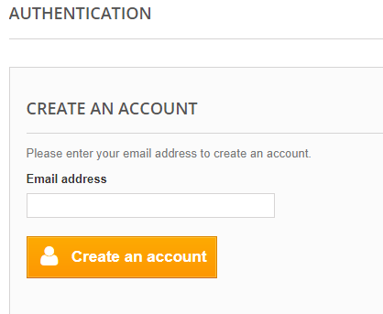
Problem: Create New Account
Open http://automationpractice.com/index.php
Open Sign In form
Fill valid email and click create account
Fill all fiends with valid data
Submit form successfully

Slide 8

Pop-up
Handle Pop-ups and Alerts

Slide 9
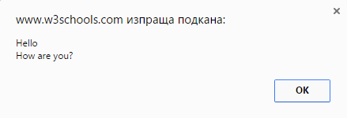
Pop-up
Graphical user interface display area, that suddenly appears in the foreground of the visual interface
Alerts
Windows
Tabs
Frames

Slide 10
SwitchTo()
Methods available under WebDriver API for Switch Commands
Switches focus to element that has focus at the moment
Switches focus to currently active dialog box
Switches focus to the window with specified name
driver.SwitchTo().ActiveElement();
driver.SwitchTo().Alert();
driver.SwitchTo().Window(string windowName);

Slide 11
SwitchTo()
Switches focus to frame by given index
Switches focus to parent frame of currently selected frame
Switches focus to the first frame on the page or main document
driver.SwitchTo().Frame(int index);
driver.SwitchTo().ParentFrame();
driver.SwitchTo().DefaultContent();

Slide 12
Alerts
Alerts can be Instantiate
Alert methods
Alert message
IAlert alert = driver.SwitchTo().Alert();
alert.Accept();
alert.Dismiss();
alert.SendKeys("Any string");
Assert.AreEqual("Expected", alert.Text);

Slide 13

Problem: Pop-up
Open http://toolsqa.com/automation-practice-switch-windows/
Click button "New Browser Tab"
Check logo have "src" attribute: http://toolsqa.com/wp-content/uploads/2014/08/Toolsqa.jpg
Close previous open tab
Check that driver handles only one window

Slide 14
Solution: Alerts
IWebDriver driver = new ChromeDriver();
driver.Url =
"http://toolsqa.com/automation-practice-switch-windows/";
var newTabBtoon = driver.FindElement(By.XPath(Add XPath));
newTabBtoon.Click();
string newTabName = driver.WindowHandles.Last();
var newTab = driver.SwitchTo().Window(newTabName);
Assert.AreEqual("QA Automation Tools Tutorial", driver.Title);
newTab.Close();
Assert.IsTrue(driver.WindowHandles.Count == 1);

Slide 15

Actions
Keyboard and Mouse Events

Slide 16
Keyboard and mouse Events
Handling special keyboard and mouse events are done using the using OpenQA.Selenium.Interactions
Actions Builder
Actions builder = new Actions(driver);
builder.MoveToElement(field).Perform();
Executing the action object

Slide 17
Keyboard Events
KeyDown() is press key and hold it pressed
KeyUp() is used to release a key you already hold
SendKeys() sends a series of keystrokes onto the element.
builder.KeyDown(Keys.Shift);
builder.KeyUp(Keys.Shift);
builder.KeyDown(Keys.Shift)
.SendKeys(element, "hello");

Slide 18
Mouse Events
Click left button at the current mouse location.
Click right button at the current mouse location.
Double click left button at the current mouse location
builder.Click();
builder.ContextClick();
builder.DoubleClick();

Slide 19
Mouse Events (2)
Moves the mouse to the middle of the element.
Clicks (without releasing) at the current mouse location.
Releases the pressed left mouse button at the current mouse location
builder.MoveToElement(field);
builder.MoveToElement(field).ClickAndHold();
builder.MoveToElement(field).Release();

Slide 20
DragAndDrop()
Performs click-and-hold from source element, moves to target element, then releases the mouse
Performs click-and-hold from source element, moves by a given offset, then releases the mouse.
Negative offset is moving left on X and moving top on Y
Builder.DragAndDrop(sourseElem, targetElem);
Builder.DragAndDropToOffset
(sourseElem, OffsetX, OffsetY);

Slide 21
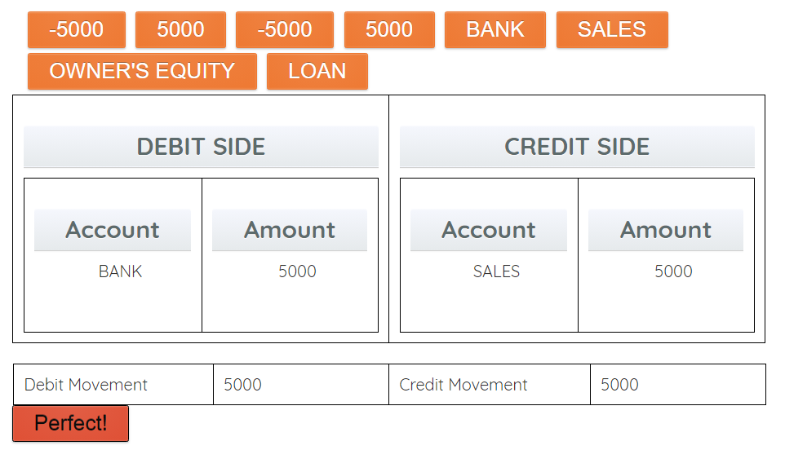
Problem: DragAndDrop
Open http://demo.guru99.com/test/drag_drop.html
Move elements to right places
Assert for button “Perfect”

Slide 22
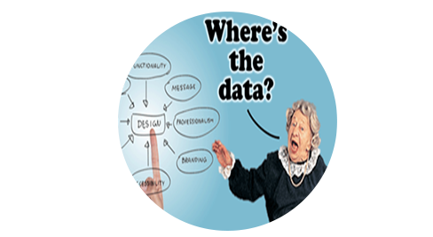
Data Driven Tests
Data Bind by Excel Files

Slide 23
What is Data Driven Testing?
Data-driven testing is the creation of test scripts to run together with their related data sets in a framework
Table of conditions directly as test inputs and verifiable outputs
Process where test environment settings and control are NOT hard-coded

Slide 24

Data Formats
Data pools
Excel files
ADO objects
CSV files
Json Files

Slide 25

Excel Data Reader
ExcelDataReader is simple library for excel doc manipulation
Get it like NuGet

Slide 26
Excel Data Reader Usage
using (var stream = File.Open(filePath, FileMode.Open, FileAccess.Read))
{
using (var reader =
ExcelReaderFactory.CreateReader(stream))
{
do
{
while (reader.Read())
{ // reader.GetDouble(0); }
} while (reader.NextResult()); } }

Slide 27
Excel Data Reader Usage (2)
using (var stream = File.Open(filePath, FileMode.Open, FileAccess.Read))
{
using (var reader = ExcelReaderFactory.CreateReader(stream))
{
var result = reader.AsDataSet(new ExcelDataSetConfiguration()
{
ConfigureDataTable = (tableReader) => new ExcelDataTableConfiguration()
{
UseHeaderRow = true,
}}); } }

Slide 28
Excel Data Reader
For .Net Core we need to add one more dependency
You need to add it manually by opening .csproj file
You can right click on project and select edit *.csproj
Add new Package Reference
<PackageReference Include="System.Text.Encoding.CodePages" Version="4.0.0"/>

Slide 29

Problem: Create Data Bind SoftUni Login
Add Data Driven Test for login in Softuni
Add one positive test case
Add one negative test case

Slide 30

Summary
Pop-ups
Handle pop-up, alerts, new tabs
Actions
Keyboard and Mouse Events

